Slide 1

Louisiana’s Charter Schools
1995 to Now:
Governance, Finance, and Access
League of Women Voters of Louisiana
Study and Consensus, 2017-2019

Slide 2

Study Guide
Why do we study charter schools in Louisiana?
    At the League of Women Voters of Louisiana’s convention in March 11-12, 2017, the delegates voted to hold a study in order to reach consensus on the efficacy of Louisiana charter school laws and their execution through the state’s existing governing structures. After initial research, the study team found it necessary to limit the scope of study to the state’s creation and governance, compliance with policies and regulations, finance and funding, and equity and accessibility of Louisiana charter schools.
How to proceed
  Reference to packet of study materials when needed
  Read ahead/ follow presentation
  Discuss issues and consensus questions
  Develop consensus/ comments
  Submit results
<number>

Slide 3
Structure of Consensus Meeting
    Roles: Facilitator, presenter, timekeeper, recorder
    Consensus is a sense of the members. Not a vote.
    Ground rules:
      Speaking time is limited. Goal: everyone speaks
      Every view respected
      Listen to learn – not to debate
      Differences are essential to learning
      Critique concepts, not people
      Dissenters often hold the key to unlock the wisdom of the group
<number>

Slide 4
Pathway to Consensus
What to look for in presentation:
  Understanding key concepts of governance, finance, and accessibility
  Discussion issues to consider when working toward consensus
  Additional documents for reference (produced by study team)
    Charter Schools 101
    Issues – Governance, Finance, and Access
    Historical sketch of charter schools
    Source List
    Introduction to study
<number>

Slide 5
Charter schools in louisiana
Over the years, education reform has taken on many iterations; the most recent has been that of public school choice. Following the federal government’s emphasis on school choice as school reform, the Louisiana legislature created the state’s first charter schools in 1995.
Charter schools serve the school choice movement in significant ways:
  Eliminating residential enrollment zones
  Limiting government regulation and oversight
  Facilitating an exchange of private and public dollars
By 2014, under the jurisdiction of the RSD, Orleans Parish was the 1st all-chartered system in the United States.
In the 2015-16 school year, just over 10% of Louisiana’s school children were enrolled in a charter school, ranking Louisiana 5th in charter enrollment in the US out of 45 states and the District of Columbia.
As of the 2017-2018 school year, there were 1,303 public schools in Louisiana, of which 146 were charter schools, making up 11% of the state’s public schools.
<number>

Slide 6
TYPES OF CHARTER SCHOOLS
<number>

Slide 7
IMPORTANT TERMS: GOVERNANCE AND OPERATIONS
BESE (Board of Elementary and Secondary Education)
  The state Board of Elementary and Secondary Education as created by the Louisiana Constitution and the Louisiana Revised Statutes develops policies and regulations to execute education law.
  The authorizer of type 2, type 4, and type 5 charter schools
LDOE (Louisiana Department of Education) or LDE
  The Department of Education includes the Recovery School District, or RSD, where references are made to type 5 charter schools.
  State Superintendent—the Superintendent of Education, who is the chief administrative officer of the Louisiana Department of Education, and who shall administer, coordinate, and supervise the activities of the department in accordance with law, regulation, and policy. He is appointed by BESE in accordance with BESE policies.
RSD (Recovery School District)
  During the 2003 regular legislative session, the Louisiana Legislature passed Act 9 to create the Recovery School District (RSD) to take over the operations of failing schools, defined as schools that do not meet the minimum academic standards for at least four consecutive years. The Superintendent of Education serves as the Recovery District’s governing authority, consistent with authority delegated by BESE and statutory authority acknowledged by BESE. The Superintendent of Education hires the RSD Superintendent, who has broad authority in procuring goods & services.
<number>

Slide 8
Charter School Authorizer
  A charter authorizer is an authorized public chartering agency that oversees the charter school. In Louisiana, the Board of Elementary & Secondary Education (BESE) and Local School Board can authorize charter schools. (www2.ed.gov)
Charter School Operator
  The terms of the charter before signing it. The operator is NOT a govern non-profit corporation under the Louisiana Secretary of State and the IRS that seeks approval of a charter from the authorizer. The application outlines operator agreements and plans for the education program, governance, leadership and management, financial plan, and facilities of the proposed charter school. The process of developing the charter application must include at least three certified teachers. The charter operator and the authorizer may further negotiate in authority. (www.doa.la.gov)
Charter School Performance Compact (CSPC)
  The current accountability framework for evaluating charter schools authorized by BESE, and it also ensures that the Louisiana Department of Education (LDOE) is accountable to charter schools. (www.louisianabelieves.com)
<number>

Slide 9
EMO (Educational Management Organization)
  Education Management Organizations (EMOs) are for-profit entities that manage charter schools and perform similar functions as CMOs. EMOs generally charge a management fee for their services to charter schools. CMOs and EMOs are different than the wide range of vendors that schools may contract with for specific services, primarily because CMOs and EMOs have considerable influence over the instructional design and operations of their affiliated charter schools. EMOs are NOT governing entities. (http://www.publiccharters.org)
CMO (Charter Management Organization)
  Nonprofit entities that manage two or more charter schools. Widely recognized CMOs include KIPP, Uncommon Schools and Achievement First, but there are many more. CMOs are not governing entities.
  (http://www.publiccharters.org)
LEA (Local Education Agency)
  The local education agency, the “LEA,” is a public board of education or other public authority legally constituted within a State that controls a public school as a political subdivision of a State. The local education agency is the receiving governing body of federal and state funding that is held responsible for complying with all federal and state laws applicable, and can be sued for non-compliance.
Charter School Board
  Governs school finances, operations, and administration; makes final decisions on staffing, accountability, and curriculum. The board is legally responsible for implementation of and compliance with all applicable law and the charter.
<number>

Slide 10
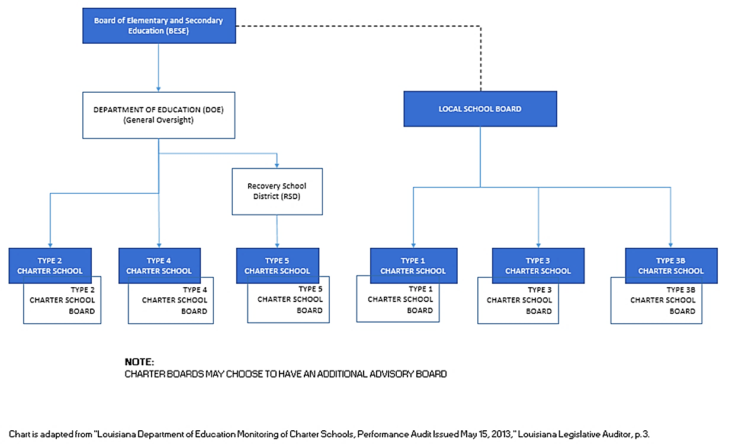
GOVERNING LOUISIANA’S CHARTER SCHOOLS
<number>

Slide 11
IMPORTANT TERMS: FINANCE
Minimum Foundation Program (MFP) for public education. "The intent of the MFP funding formula is to balance the desire for funding equity across school districts with the desire to encourage local school districts to provide strong financial support for education.“ (The everyday person's guide to public education funding in Louisiana. OPENNOLA.org
<number>

Slide 12
IMPORTANT TERMS: ACCESSIBILITY
FAPE (free appropriate public education) (https://www2.ed.gov)
  Free Appropriate Public Education for Students With Disabilities:
      Requirements Under Section 504 of
      The Rehabilitation Act of 1973 IDEA
  Section 504 of the Rehabilitation Act of 1973 protects the rights of individuals with disabilities in programs and activities that receive federal financial assistance, including federal funds. Section 504 provides that: “No otherwise qualified individual with a disability in the United States . . . shall, solely by reason of her or his disability, be excluded from the participation in, be denied the benefits of, or be subjected to discrimination under any program or activity receiving Federal financial assistance . . .”¹
¹ “Charter schools and students with disabilities, preliminary analysis of the legal issues and areas of concern”, Center for Law and Education under contract with the Council of parent attorneys and advocates, 2012.
<number>

Slide 13
At-Risk Students R.S. 17:1942
  is eligible to participate in the federal Free and Reduced Price Lunch program
  is under the age of twenty and has been withdrawn from school prior to graduation for not less than one semester or have failed to achieve the required score on any portion of the examination required for high school graduation
  is in the eighth grade or below and is reading two or more grade levels below grade level
  has been identified as a student with an exceptionality* (not including gifted and talented)
  is the mother or father of a child
FRL (Free and Reduced Lunch)
  R.S.17:3991(B) outlines the requirements for at risk enrollment for state authorized charters (Type 2) on the FRL (free and reduced lunch) and special education populations of the enrollment zone. Because type 2 charter schools have a statewide enrollment zone, the LDE uses the statewide percentage of FRL to establish the target percentage. Currently the FRL percentage is at 67% of public school students, meaning that type 2 charter schools should have an at risk population of at least 67%.
<number>

Slide 14

Governing Education
The League of Women Voters of US: Impact on Issues
Promote an open governmental system that is representative, accountable, and responsive at every level--federal, state, and local.
Accountability for the LWVUS is providing adequate government oversight and control of a public service in order to ensure taxpayer dollars are used efficiently and effectively for that service.
<number>

Slide 15
Governing Education
The League of Women Voters of US: Impact on Issues
Democratic government depends upon informed and active participation in government and requires the public’s right to know.
Transparency as required in open meetings laws and public records law;
Access to and participation in all meetings of any governmental body.
<number>

Slide 16

Governing Education
The League of Women Voters of US: Impact on Issues
Equality of Opportunity for Education
Privatization of services fundamental to the governance of a democratic society should not be privatized in their entirety, including public education.
<number>

Slide 17
Governing Charter Schools
Outlining the Issues
Authorization
There is no cap on the number of Type 2 charter schools BESE may authorize in a school district. BESE may vote to reverse a local school board’s decision not to approve a charter operator’s application for a Type 1 charter.
BESE may also approve a charter operators’ contract that allows an operator to establish several charter schools in the same local school district, if the operator’s other charter schools meet BESE’s requirements. (BESE Bulletin 126, Section 518]
When Type 2 charter schools open, state dollars including an amount equal to the local tax contribution for public school students via the MFP (Minimum Foundation Program) follow the student from the district school to the charter school.
<number>

Slide 18

Local Oversight
A charter school’s board members are either the same members of the board of the non-profit charter corporation, the operator, that is chosen by BESE to govern the charter school, or else the members are chosen directly by that board. Local voters do not vote on a board nor can they recall members of a board of a charter school. Types 1, 3 and 3B charter schools are authorized by a local school board and therefore, have some oversight by local voters.
BESE is the body of appeal for parents to be heard for Type 2 charter school students after first seeking redress from the charter school board. BESE meets in Baton Rouge during weekday work hours, making it difficult for family members to attend to pursue grievances.
<number>

Slide 19
Local Oversight (continued)
Under Louisiana law, a charter school board is a political subdivision of the state; the public meetings law applies. However, random review of charter school websites shows many do not meet regularly, nor post the charter school board’s upcoming meetings or the minutes on their website and that some boards meet out of town.
The specifics of charter school governance and the number of references to further details are not easily located, but must be searched across BESE bulletins, state laws, & the Department of Education’s website. Without clear and adequate context, any proposed charter school legislation cannot be adequately examined or debated as to its intent or consequences or potential for the state, communities, parents, and students.
<number>

Slide 20
Accountability
BESE requires the Department of Education to monitor and quantify Types 2, 4, and 5 schools’ annual self-monitoring internal review, and conduct an external review through an on-site evaluation. The Legislative Auditor by law audits the Department’s evaluation findings on fiscal, academic, organizational and legal contractual performance.
The Legislative Auditor has reported to the legislature and the public insufficient monitoring and insufficient compliance in performance and use of a scoring system rating violations in both critical and non-critical areas equally. The Department of Education’s responses disagreed with interpretation of state law, cited insufficient funding & stated its already once revised evaluation instrument & annual on-site visits are adequate. BESE relies on the Department’s data to decide whether to renew or terminate Type 2, 4, and 5 charters.
The dual public and private relationships of charter schools continue to be challenged legally. The Louisiana Legislative Auditor lists charter school audits in their own category, separate from quasi-public and public entities, and allows them to report on either the nonprofit or governmental model. The National Labor Relations Board followed a U.S. Supreme Court’s decision in ruling an entity is a political subdivision if it is created directly by the state as an administrative type of department and if its administrators are “responsible to public officials or to the general electorate.” It found the charter schools to be private corporations with privately appointed boards, in the manner of government contractors.
<number>

Slide 21
Orleans Parish
Act 35, 2016, began the return of more than 80 Type 5 charter schools under the RSD to the jurisdiction of the Orleans Parish School Board as 3B charter schools by July, 2018. However, the legislature limited that jurisdiction’s powers to govern the charter schools, by preserving their boards’ areas of contractual autonomy, continuing as individual Local Education Agencies (LEA), and the collaboration of charter school advocacy non-profits with BESE to determine the Minimum Foundation Program funding allocation to the Orleans Parish School Board.
<number>

Slide 22
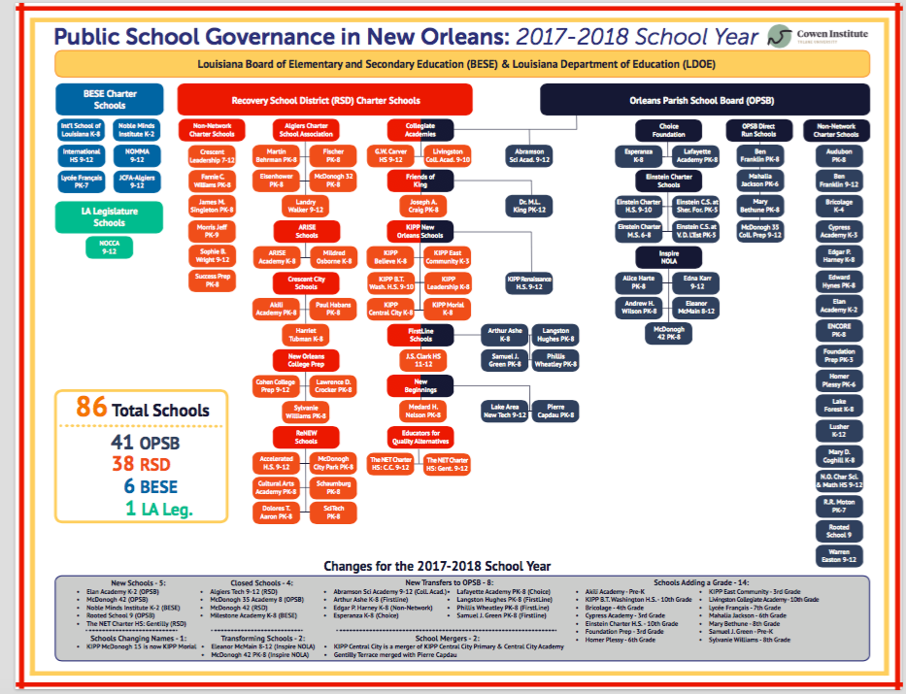
<number>

Slide 23
LWV-LA CONSENSUS QUESTIONS: governance
1. Which governing entity or entities should be granted the power to authorize a charter school? [choose one]
___ a. BESE and the local school boards (current law)
___ b. Only BESE
___ c. Only local school boards
___ d. No consensus
COMMENTS:
2. Should the number of Board of Elementary and Secondary Education (BESE)-authorized Type 2, 4, and 5 charter schools in Louisiana be limited or “capped”?
___ a. Yes
___ b. No
___ c. No consensus
COMMENTS:
<number>

Slide 24
3. Current Louisiana law allows each charter school’s board to contract for the charter
school’s day-to-day operations with either a non-profit or for-profit charter management organization. Should contracting with for-profit charter management organizations be legal?
___ a. Yes
___ b. No
___ c. No consensus
COMMENTS:
4. Should it be a requirement for authorization that charter school boards [Select all that apply]:
___ a. include at least one parent/guardian of children attending that school
___ b. include some representation of the various demographic groups within that school board’s jurisdiction
___ c. represent the geographical area of the students attending that school, regardless of type of charter school
___ d. No consensus
COMMENTS:
<number>

Slide 25
5. Act 91 by New Orleans Senator Karen Carter Peterson, passed in the 2016 Regular Legislative Session, required all RSD schools to be returned to the jurisdiction of the Orleans Parish School Board by July 1, 2019. In the same way, should there be a general law applying to any local school district in Louisiana to establish a formal process and timeline for the return of a Recovery School District’s charter school, or schools, to the jurisdiction of its local school board?
___ a. Yes
___ b. No
___ c. No consensus
COMMENTS:
<number>

Slide 26
6. What further steps beyond early revocation or in the contract’s renewal should BESE, local school boards, and the legislature take to ensure full compliance with federal and state applicable laws and with BESE policies? [Select all that apply]
___ a. Require unannounced visits and assessment of each charter school throughout each year
___ b. Require higher and more specifically outlined academic, financial and/or organizational standards, or goals, to be met for both initial and renewal contracts
___ c. Authorize a maximum of only five years for renewal for any charter, regardless of its outcomes
___ d. Reduce a school’s board contract to one year before renewal upon any violation of its charter, unless preferable to close the school by the end of that school year
___ e. Limit the number of charter schools that can be authorized until full compliance is reached by those schools BESE or the local school board has already authorized or closed
___ f. Require a new contract for each charter school proposed by the same existing charter school operator; disallow any operator whose charter school was closed from opening another in Louisiana
___ g. Protect whistleblowers from retaliation
___ h. No consensus
COMMENTS:
<number>

Slide 27
7. For transparency, BESE should require each charter school’s board to maintain open access to a website that provides, at a minimum, which of the following (Select all that apply):
___ a. its entire contract with its authorizer
___ b. adequate public notice of upcoming board meetings
___ c. a list of the current board and board member’s contact information
___ d. approved minutes of each board meeting sequentially for each year and past years
___ e. the most current School Performance Score
___ f. an explanation of the complaint and appeal process
___ g. discipline policies or student/parent handbook containing them
___ h. contact information for the school, including the address and name of the school leader
___ i. school’s annual financial reports
COMMENTS:
<number>

Slide 28
8. Louisiana Department of Education’s duties should include:
___ a. marketing and recruitment of qualified applicants as charter operators
___ b. negotiating or brokering agreements towards charter school approval by Board of Elementary and Secondary Education
___ c both a. and b.
___ d. neither a. nor b.
___ e. no consensus
<number>

Slide 29
Funding and Finance of Charter Schools
The League of Women Voters of US: Impact on Issues
The League of Women Voters … recognize(s) that primary responsibility for public education resides with the states. In accordance with the League of Women Voters’ position on Equal Rights, the League continues to support equity in public education for all through:
Broad guidelines for accountability, leaving implementation to the state and local education agencies.
Adequate funding sources that support the broad goals of national standards.
Mechanisms for local and state funding with adequate federal support for mandates that require less burdensome, compliance-based reporting and regulations.
<number>

Slide 30
Funding and Finance of Charter Schools
The League of Women Voters of US: Impact on Issues
Policy on privatization of public services:
The League believes that when governmental entities consider the transfer of governmental services, assets and/or functions to the private sector, the community impact and goals of such transfers must be identified and considered. Further, the League believes that transparency, accountability, and preservation of the common good must be ensured.
<number>

Slide 31
Funding and Finance of Charter Schools
The League of Women Voters of US: Impact on Issues
Policy on privatization of public services: Specific recommendations:
Cost-benefit analyses evaluating short and long term costs of privatization, including the ongoing costs of contract administration and oversight
An understanding of the impact on customers, the broader community, environment and public employees
An open, competitive bidding process with clearly defined criteria to be used in selecting a contractor
A provision or process to ensure the services or assets will be returned to the government if a contractor fails to perform
<number>

Slide 32
Funding and Finance in Charter Schools
Outlining the Issues
Charter schools in Louisiana are funded through the state Minimum Foundation Program (MFP) which is allocated according to a formula on a per-pupil basis. Funding of charter schools can have a financial impact on local school districts where students formerly in their attendance zones attend charter schools.
The Louisiana Legislature, the Board of Elementary and Secondary Education and the Louisiana Department of Education are responsible for adequate funding of education and effective oversight of the finances of both school districts and charter schools.
The following are potential issues that could impact effective funding and financial controls in Louisiana schools:
<number>

Slide 33
Funding and Finance in Charter Schools
Outlining the Issues
Funding of charter schools and impacts on districts
The funding of charter schools with MFP per-student monies can impact the budgets of school districts when students leave their district enrollment zone to attend charter schools. Districts pay fixed costs for buildings, maintenance, staff and costs such as the unfunded accrued liability of teacher retirement systems, from reduced MFP. Virtual charter schools providing at-home computer-based learning are funded at a per-pupil rate of 90% of MFP. Impacts of these funding mechanisms on school districts is not currently weighed by authorizers.
Funding of charter school facilities
Type 2 charter schools are typically housed in privately constructed and owned buildings which are leased to the charter school board. Lease payments over time can be costly. The taxpayer does not accrue any equity in the building as the building remains privately owned and may be sold by the owner if the charter school closes for any reason.
<number>

Slide 34
Funding and Finance in Charter Schools
Outlining the Issues
Financial oversight of charter schools
  Many charter schools are operated through management-fee based arrangements with EMOs and CMOs (for-profit and not-for-profit management organizations). While the financial records of charter schools boards must be reported quarterly and an annual qualified audit submitted, EMO and CMO financial records are not reported or audited.
  The oversight of financial records and audits is not timely and consistent. The Legislative Auditor points out in its performance audit, Louisiana Department of Education Monitoring of Charter Schools (2013), that the Louisiana Department of Education does not have a timely process to determine if schools placed 'on probation', that is, in intervention levels beyond good standing, have returned to good standing and has allowed schools to continue to operate in the succeeding school year without evidence of correction.
  Charter schools are required to follow public bid law only for public works projects (publicly owned or leased buildings) in excess of $150,000 and food service.
  Moveable, reusable property (computers, desks, etc.) remain the property of the charter school when a charter school closes.
<number>

Slide 35
LWV-LA CONSENSUS QUESTIONS: finance & funding
9. Should all state of Louisiana public education mandates be funded so as not to place a financial burden on the budgets of local districts that have charter schools in their enrollment zones?
___ a. Yes
___ b. No
___ c. No consensus
COMMENTS:
10. Should the allocation of state funding per student to virtual charter schools (computer-based distance learning) be reviewed and evaluated at required intervals to determine whether their funding level is appropriate?
___ a. Yes
___ b. No
___ c. No Consensus
COMMENTS:
<number>

Slide 36
11. If a facility used for a charter school is privately owned and leased using MFP or other public funds, the terms of the mortgage or lease shall be disclosed, evaluated by the Louisiana Department of Education and the Board of Elementary Education, and reported publicly to protect the taxpayer's interest in the facility being retained at reasonable cost.
___ a. Yes
___ b. No
___ c. No Consensus
COMMENTS:
12.When a charter school board contracts with not-for-profit or for-profit charter school management organizations, should the financial records of the management organization be required to be disclosed, subject to financial oversight, and audited annually?
___ a. Yes
___ b. No
___ c. No consensus
COMMENTS:
<number>

Slide 37
13. Should the Louisiana Department of Education require prompt compliance by the charter school to any material findings issued by Louisiana’s Legislative Auditor in its review of Types 2, 4 and 5 charter schools?
___ a. Yes
___ b. No
___ c. No Consensus
COMMENTS:
14. As a recipient of public education funds, should charter school boards be required to meet the same procurement requirements as other public schools, including competitive bids and public disclosure for: [Select all that apply]
___ a. Acquisition of sites __Yes __No __ No consensus
___ b. Construction of facilities __Yes __No __ No consensus
___ c. Purchasing of supplies __Yes __No __ No consensus
___ d. Purchasing of equipment __Yes __No ___No consensus
___ e. Purchasing of services __Yes __No ___No consensus
___ f. Other (specify) __________________________________________
COMMENTS:
<number>

Slide 38
15. Should all movable property, equipment, and reusable supplies purchased by a charter school with public dollars be surrendered to the authorizer if the charter school closes for any reason?
___ a. Yes
___ b. No
___ c. No consensus
COMMENTS:
<number>

Slide 39

Accessibility and Equity in Charter Schools
The League of Women Voters of US: Impact on Issues
The League of Women Voters believes that the federal government shares with other levels of government the responsibility to provide equality of opportunity for education, employment and housing for all persons in the United States regardless of their race, color, gender, religion, national origin, age, sexual orientation or disability.
The League is committed to racial integration of schools as a necessary condition for equal access to education.
The League of Women Voters believes that an equitable, quality public education is critical for students. While the League recognizes that there are instances where the federal government’s involvement is the only way to achieve universal change (desegregation, special needs population, gender equity), we also recognize that primary responsibility for public education resides with the states. In accordance with the League of Women Voters’ position on Equal Rights, we continue to support equity in public education for all through: Broad guidelines for accountability, leaving implementation to the state and local education agencies; Adequate funding sources that support the broad goals of national standards; and mechanisms for local and state funding with adequate federal support for mandates that require less burdensome, compliance-based reporting and regulations.
<number>

Slide 40
Accessibility and Equity in Charter Schools
Outlining the Issues
The creation of charter schools in Louisiana has introduced mechanisms that change the way parents and guardians enroll children in public schools, the manner in which school sites are determined, and the administration of school services and oversight of their execution. The Board of Elementary and Secondary Education and the Louisiana Department of Education, along with local education governing agencies are ultimately responsible for monitoring and oversight of enrollment and administrative practices. The following are issues or potential issues that could threaten equal access to and equity among Louisiana’s public schools
<number>

Slide 41
Accessibility and Equity in Charter Schools
Outlining the Issues
Transportation
  Free transportation for students is a tool that ensures that students with limited resources have reliable and consistent access to school. It allows districts to balance enrollment and meet the demands for special education services. As of 2018, Type 2 charter schools will be required to provide free transportation to their students. Monitoring for compliance with existing and new regulations is critical.
Special Education Delivery
  Special education delivery requires additional expenses for schools. Systems which have multiple sites for special education delivery and have larger populations of students requiring specialized services are able to better utilize economies of scale to effectively administer and deliver services. Charter schools, which typically have much smaller populations of special needs students and students who have different needs, face obstacles to providing highly specialized services in a cost effective way. An additional concern deals with oversight and monitoring of special education services. Because of the decentralized nature of charter schools in Louisiana, charter boards and authorizers must be extra diligent in ensuring compliance and maintaining proper channels for parent grievances.
<number>

Slide 42
Accessibility and Equity in Charter Schools
Outlining the Issues
Enrollment Balance
  Charter schools are open enrollment institutions. Charter school lottery systems are currently in place to manage enrollment of children in charter schools. The Louisiana constitution mandates that charter schools achieve an integrated student body consistent with the district in which it resides. A challenge for many jurisdictions is to balance enrollment so that racial isolation does not occur. Neighborhood segregation has long worked against many districts attempting to achieve enrollment balance. What often follows this situation is an inadequate balance of staff and resources that tend to flow toward well-resourced areas of districts.
Discipline Procedures
  The laws for the discipline of students are outlined in Louisiana Revised Statutes 17. Laws regarding corporal punishment, suspension, and expulsion from schools are required to be consistent across traditional and charter schools. In addition, schools are required to develop a master plan for student behavior supports and discipline. Concerns exist regarding equitable administration of discipline policy in a more decentralized charter environment.
<number>

Slide 43
Accessibility and Equity in Charter Schools
Outlining the Issues
The October 2017 legislative audit indicated the Department of Education conducted all required annual reviews. However, using the Compass instrument the LDE took away the same number of points for violation of minor standards as it did for violating state laws, including ADA requirements, suspension rates, expulsion rates, student enrollment and at-risk percentage, and the school’s following the required recruitment and enrollment plan and lottery procedures.
The Louisiana legislature has recently approved several public charter schools that are identifiable as schools for students with disabilities, previously called “special education schools” for students ages 3-21. These schools were cited by the Southern Association of Colleges and Schools, now AdvanceED, for segregating students, and were recommended to close them and serve those students on school campuses with their non-disabled peers as the least restrictive environment and as the opportunity to learn on age-appropriate campuses.
<number>

Slide 44
Accessibility and Equity in Charter Schools
Outlining the Issues
Louisiana’s legislative auditor in its recent report issued several findings in violation of the at-risk enrollment mandate and expressed concern with a lack of institutional efforts on the part of the LDE to remedy the issue. The October 2017 audit in part indicated that the Department of Education did not monitor whether the required percentage of at-risk students were enrolled and whether a lottery was held because there were more applicants than seats left. 19% of the 2015-2016 schools monitored did not enroll the required number of at-risk students and the Department did not review schools’ enrollment lottery processes for compliance.
Parents of charter school students in New Orleans have raised concerns regarding high rates of suspension among minority students as well as lack of an adequate grievance processes for disciplined students. Recently, schools in New Orleans have developed a common expulsion process that allows for a third-party review central to the city’s schools. In news reports, there has been discussion of inconsistent expectations among various charter schools for minor discipline infractions like uniform violations and classroom disruption. These reports leave open questions about the degree to which charter schools use restorative justice practices that work to reduce rates of suspension and encourage a mediation process instead.
<number>

Slide 45
LWV-LA CONSENSUS QUESTIONS: accessibility & equity
16. How should the Louisiana Department of Education (LDE) and the Board of Elementary and Secondary Education (BESE) work to ensure that the needs of special education students are met in Louisiana’s charter schools? (Select all that apply)
___ a. Regular monitoring by LDE staff of charter school identification and evaluation process for student populations suspected of having a disability
___ b. Well-trained, certified LDE staff to conduct on site monitoring of school practices for students with special needs
___ c. Transparent and easily accessible recourse for parents/guardians of students with special needs for understanding rights of students and responsibilities for schools, as well as process to register grievances
___ d. Discipline plans consistent with best practices for special needs students and monitored for compliance
___ e. No consensus
COMMENTS:
<number>

Slide 46
17. Should transportation services for all charter schools be consistent with those required for traditional public schools?
___ a. Yes
___ b. No
___ c. No Consensus
COMMENTS:
18. Should any transportation waiver issued by the Louisiana Department of Education (LDE) and the Board of Elementary and Secondary Education (BESE) require a public process and provide for public details outlining the reasons for the waiver?
___ a. Yes
___ b. No
___ c. No Consensus
COMMENTS:
<number>

Slide 47
19. Should Board of Elementary and Secondary Education (BESE) and the local school board as authorizers prioritize the proposed location of a charter school? (Choose one):
___ a. No, the location should be determined by market forces.
___ b. Yes, the authorizer should determine the location of the charter school in negotiation with the charter school operator.
___ c. No consensus
COMMENTS:
20. Should Louisiana’s charter school authorizers exercise authority over enrollment practices of charter schools to ensure that they meet their statutory obligations for a balance of enrollment that reflects the enrollment of the school district in which the charter school resides?
___ a. Yes
___ b. No
___ c. No Consensus
COMMENTS:
<number>

Slide 48
21. Which of the following measures should the Louisiana Department of Education (LDE) take to ensure that each charter school complies with at-risk enrollment law (Select all that apply):
___ a. Require demonstration of their yearly progress toward the target enrollment resulting from recruitment efforts
___ b. Revoke the charter of schools that fail after a specified period of time to show substantial growth.
___ c. Decline to renew the charter of a school that is unable to meet the at risk enrollment requirement
___ d. Annually monitor and report to public efforts on the part of the non-compliant charter schools to recruit and retain at-risk students.
___ e. No Consensus
COMMENTS:
<number>

Slide 49
22. Should charter school authorization be contingent upon a detailed review and impact analysis of enrollment across the school district in which the charter school applicant seeks approval?
___ a. Yes
___ b. No
___ c. No Consensus
COMMENTS:
23. Should the Board of Elementary and Secondary Education (BESE) and the Louisiana Department of Education (LDE) ensure that students’ civil rights are protected in every education setting, including charter schools?
___ a. Agree
___ b. Disagree
___ c. No Consensus
COMMENTS:
<number>

Slide 50
24. Should the Louisiana legislature allow for special charter schools that serve only populations such as students with federal disability or 504 classifications as a: (Select which apply)
A. Day special school?
___ a. Yes
___ b. No
___ c. No consensus
B. Residential special school
___ a. Yes
___ b. No
___ c. No consensus
COMMENTS:
<number>

Slide 51

You have done a marvelous job indeed! You have completed
the League of Women Voters of Louisiana consensus on ‘Charter Schools Study’
<number>

